Slide 1
5~6. Basic Computation
[ECE20016/ITP20003] Java Programming
Notes:
‹#›

Slide 2
Agenda
Variables and Expressions
The Class String
Keyboard and Screen I/O
Documentation and Style

Slide 3
Variables
Variables in a program are used to store data such as numbers and letters.
Places to store data.
They are implemented as memory locations.
Store a particular type of data.
The data stored by a variable is called its value.
A variable must be declared before it is used.

Slide 4
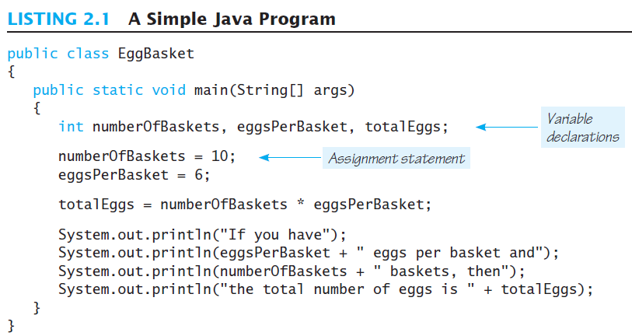
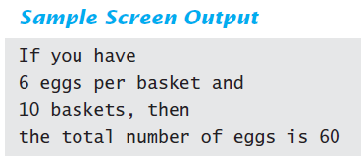
EggBasket

Slide 5
Naming and Declaring Variables
Variable declaration:
Type Variable_1, Variable_2, ...;
Ex) int numberOfBaskets;
int eggsPerBasket;
int totalEggs;
A variable's type determines what kinds of values it can hold (int, double, char, etc.).
Choose names that are helpful such as count or speed, but not c or s.
Variable declaration can be concatenated by comma operator
Ex) int numberOfBaskets, eggsPerBasket, totalEggs;

Slide 6
Storing Values to Variables
Assignment
Variable = Expression;
The "equal sign" is called the assignment operator.
Cf. Mathematical equal operator: ‘==’
Expression can be one of followings
Another variable
A literal or constant (such as a number)
Something more complicated which combines variables and literals using operators (such as + and -)
Ex) numberOfBaskets = 10;
eggsPerBasket = 6;
score = numberOfCards + handicap;
eggsPerBasket = eggsPerBasket - 2;

Slide 7
Data Types
A class type is used for a class of objects (data + methods).
"Java is fun" is a value of class type String
➔ Type for complex data
A primitive type is used for simple, non-decomposable values such as an individual number or individual character.
int, double, and char are primitive types.
➔ Type for simple data

Slide 8
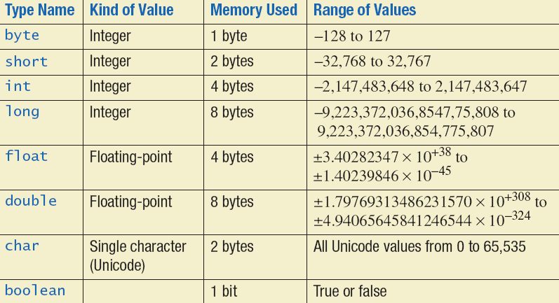
Primitive Types
Ex) short day = 10;
float cost = 195.20;
char initial = ‘i’;
boolean flag = true;

Slide 9
Primitive Types
Integer types (byte, short, int, and long)
Ex) 0, -1, 365, 124565465464467
int is most common
Floating-point types (float and double)
Ex) 0.99, -22.8, 3.14159, 5.0
double is more common
Floating-point numbers often are only approximations since they are stored with a finite number of bits.
Ex) 1.0/3.0 is slightly less than 1/3
Character type (char)
Ex) 'a' 'A' '#' ' '
Boolean type (boolean)
true or false

Slide 10
Java Identifiers
An identifier is a name, such as the name of a variable.
Identifiers may contain only
Letters
Digits (0 through 9)
The underscore character (_)
And the dollar sign symbol ($) which has a special meaning
Mainly for auto-generated names.
The first character cannot be a digit.
Java is case sensitive
Ex) stuff, Stuff, and STUFF are different identifiers.
An identifier cannot be a keyword (or reserved word) used for special, predefined meanings in Java.
Ex) int, static, public, for, return, …

Slide 11
Naming Conventions
Class types begin with an uppercase letter (e.g. String).
Primitive types begin with a lowercase letter (e.g. int).
Variables of both class and primitive types begin with a lowercase letters (e.g. myName, myBalance).
Multiword names are "punctuated" using uppercase letters. (e.g. studentName)

Slide 12
Where to Declare Local Variables
Declare a variable
Just before it is used or
At the beginning of the section of your program that is enclosed in {}.
public static void main(String[] args)
{
/* declare variables here */ . . . }

Slide 13
Initializing Variables
A variable that has been declared, but not yet given a value is said to be uninitialized.
Uninitialized class variables have the value null.
Uninitialized primitive variables may have a default value.
It's good practice not to rely on a default value.
To protect against an uninitialized variable (and to keep the compiler happy), assign a value at the time the variable is declared.
Ex) int count = 0;
char grade = 'A';

Slide 14
Simple Input
Data can be entered from the keyboard using
Scanner keyboard = new Scanner(System.in);
Followed, for example, by
eggsPerBasket = keyboard.nextInt();
Reads one int value from the keyboard and assigns it to eggsPerBasket.

Slide 15
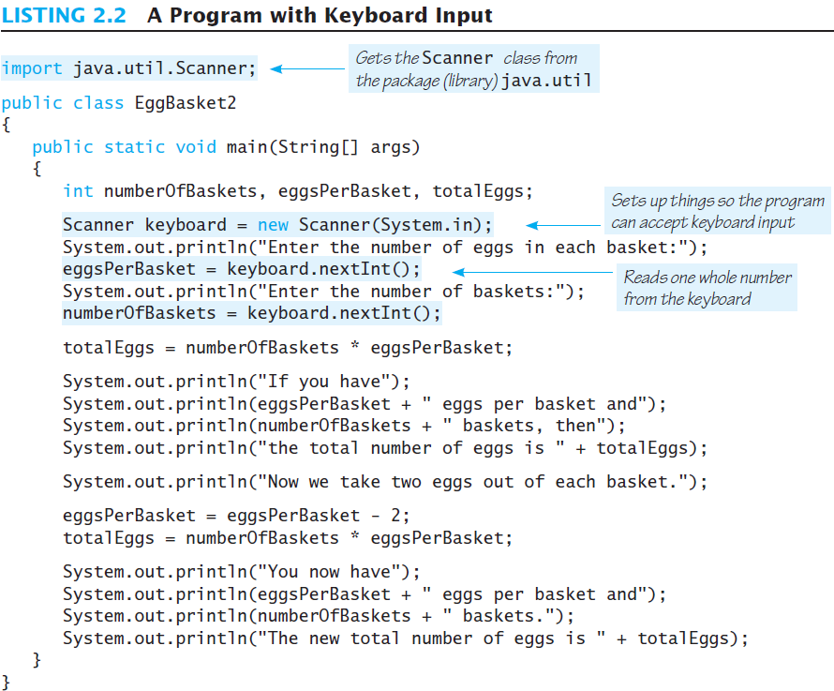
Simple Input

Slide 16
Simple Screen Output
Syntax
System.out.println(<contents to display>);
Ex) System.out.println("The count is " + count);
Outputs the string literal "the count is "
Followed by the current value of the variable count.

Slide 17
Constants
Literal expressions such as 2, 3.7, or 'y' are called constants.
Numeral constants can be preceded by a + or – sign
Floating-point constants can be written
With digits after a decimal point or
Using e notation.
Ex) 865000000.0 ➔ 8.65e8 // denotes 8.65*10⁸
0.000483 ➔ 4.83e-4 // denotes 4.83*10⁻⁴
The number in front of the e does not need to contain a decimal point.
Named constants using the 'final' modifier
public static final Type Variable = Constant;
Ex) public static final double PI = 3.14159;

Slide 18
Assignment Compatibilities
Java is said to be strongly typed.
Ex) You can't assign a floating point value to a variable declared to store an integer.
Sometimes conversions between numbers are possible.
Ex) doubleVariable = 7;
byte --> short --> int --> long --> float --> double
But not to a variable of any type further to the left.
char --> int

Slide 19
Type Casting
A type cast temporarily changes the value of a variable from the declared type to some other type.
Ex)
double distance = 9.0;
int points = (int)distance;
Illegal without (int)
The value of (int)distance is 9,
Any nonzero value to the right of the decimal point is truncated rather than rounded.
The value of distance, both before and after the cast, is 9.0.

Slide 20
Arithmetic Operators
Arithmetic expressions can be formed using
Operators, such as +, -, *, and /
Operands, such as variables or numbers
Type of expression
When both operands are of the same type, the result is of that type.
When one of the operands is a floating-point type and the other is an integer, the result is a floating point type.
Ex) int hoursWorked = 40;
double payRate = 8.25;
➔ hoursWorked * payRate is a double with a value of 500.0.

Slide 21
Arithmetic Operations
Expressions with two or more operators can be viewed as a series of steps, each involving only two operands.
Ex) balance + (balance * rate)
The result is the rightmost type from the following list that occurs in the expression.
byte --> short --> int --> long --> float --> double

Slide 22
Arithmetic Operators
Division operator
When both operands are integer types, the result is truncated, not rounded.
Ex) 99/100 has a value of 0.
The mod (%) operator is used with operators of integer type to obtain the remainder after integer division.
Ex) 14 % 4 is equal to 2. // 14 = 4 * 3 + 2.
The mod operator has many uses, including
Determining if an integer is odd or even
Determining if one integer is evenly divisible by another integer.

Slide 23
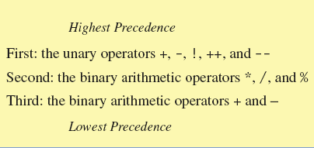
Parentheses and Precedence
Parentheses can communicate the order in which arithmetic operations are performed.
Ex) (cost + tax) * discount
cost + (tax * discount)
Without parentheses, an expressions is evaluated according to the rules of precedence.

Slide 24
Precedence Rules
When binary operators have equal precedence
Left to right precedence
Ex) 5 + 3 - 2
When unary operators have equal precedence.
Right to left precedence
Ex) - ++a // ! ++a is NOT a valid Java expression

Slide 25
Making Code Clearer
Even when parentheses are not needed, they can be used to make the code clearer.
balance + (interestRate * balance)
Spaces also make code clearer
Ex) balance + interestRate*balance

Slide 26
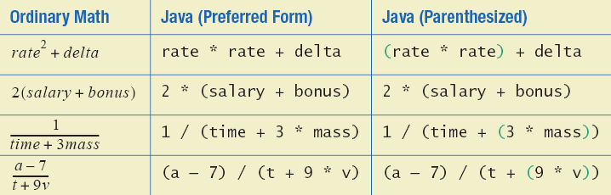
Sample Expressions

Slide 27
Specialized Assignment Operators
Assignment operators can be combined with arithmetic operators (including -, *, /, and %, discussed later).
Ex) amount = amount + 5;
can be written as
amount += 5;

Slide 28
Increment and Decrement Operators
Used to increase (or decrease) the value of a variable by 1
Easy to use, important to recognize
The increment operator
count++ or ++count
The decrement operator
count-- or --count

Slide 29
Increment and Decrement Operators
Equivalent operations
count++;
++count;
count = count + 1;
count--;
--count;
count = count - 1;

Slide 30
Increment and Decrement Operators in Expressions
Ex)
int m = 4;
int result = 3 * (++m);
➔ After executing, result has a value of 15 and m has a value of 5
Ex)
int m = 4;
int result = 3 * (m++)
➔ After executing, result has a value of 12 and m has a value of 5

Slide 31
Agenda
Variables and Expressions
The Class String
Keyboard and Screen I/O
Documentation and Style

Slide 32
The Class String
A value of type String is a
Sequence of characters
Treated as a single item.
Ex) "Enter a whole number from 1 to 99.“

Slide 33
String Constants and Variables
Declaring
String variale_name;
Ex) String greeting;
greeting = "Hello!";
or
String greeting = "Hello!";
or
String greeting = new String("Hello!");
Printing
System.out.println(greeting);

Slide 34
Concatenation of Strings
Two strings are concatenated using the + operator.
String greeting = "Hello";
String sentence;
sentence = greeting + " officer";
System.out.println(sentence);
Any number of strings can be concatenated using the + operator.

Slide 35
Concatenating Strings and Integers
String solution;
solution = "The answer is " + 42;
System.out.println (solution);
The temperature is 72
The answer is 42

Slide 36
String Methods
An object of the String class stores data consisting of a sequence of characters.
Objects have methods as well as data
Note: object = data + operations

Slide 37
The Method length()
The length() method returns the number of characters in a particular String object.
String greeting = "Hello"; int n = greeting.length();
The method length() returns an int.
You can use a call to method length() anywhere an int can be used.
int count = command.length();
System.out.println("Length is " + command.length());
count = command.length() + 3;

Slide 38
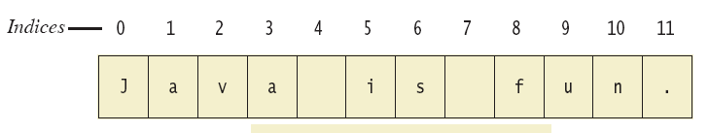
String Indices
A position is referred to an index.
Positions start with 0, not 1.
Ex) The 'J' in "Java is fun." is in position 0
Ex) The 'f' in "Java is fun." is at index 8.

Slide 39
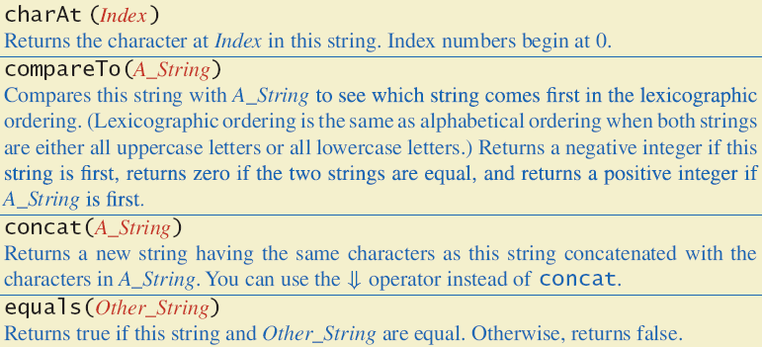
String Methods

Slide 40
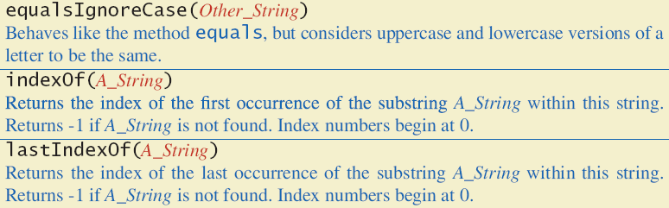
String Methods

Slide 41
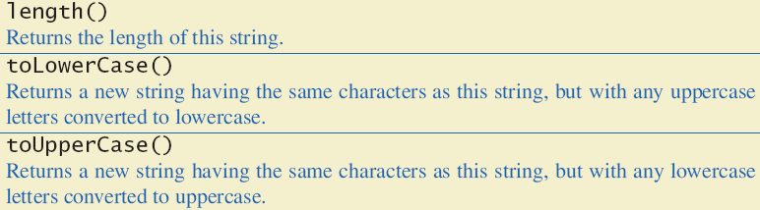
String Methods

Slide 42
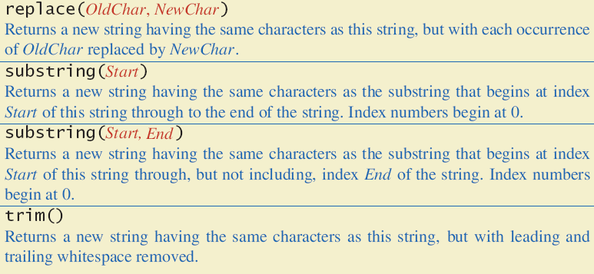
String Methods

Slide 43
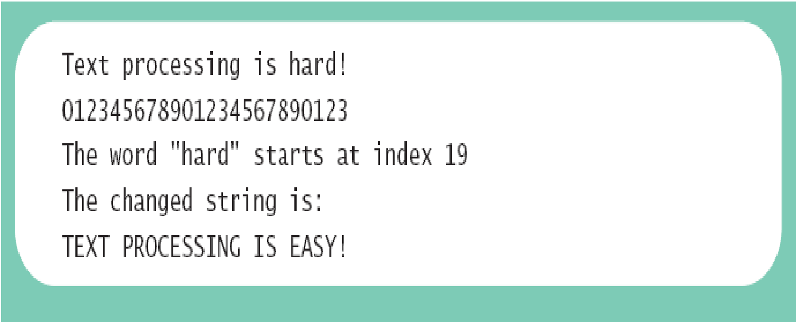
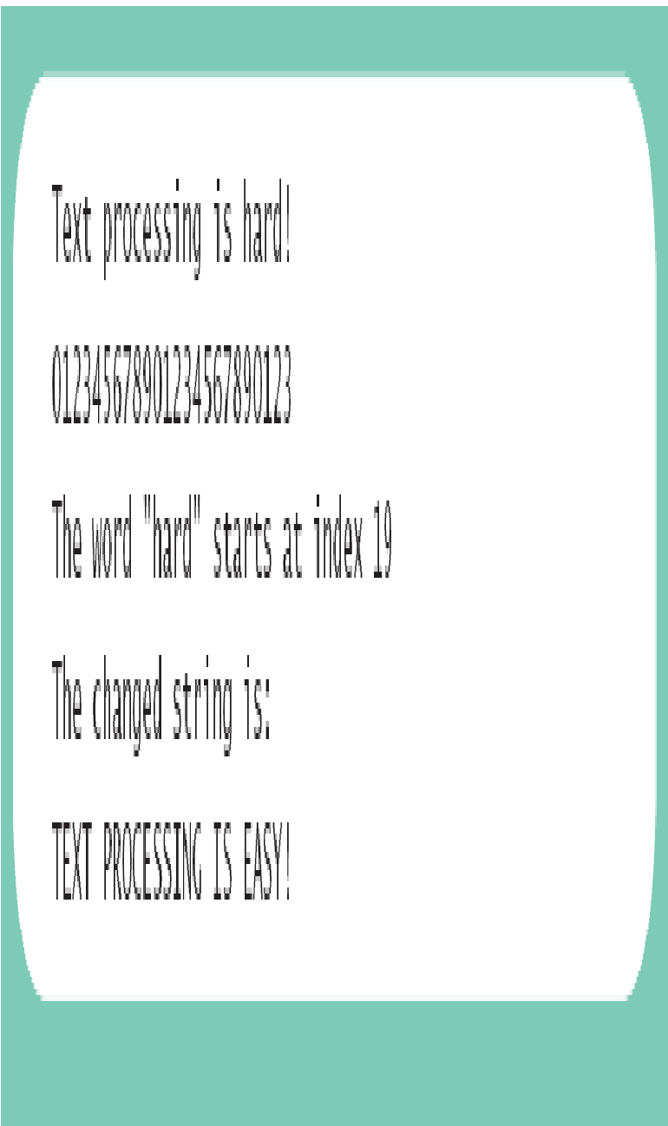
String Processing
public class StringDemo
{
public static void main (String [] args)
{
String sentence = "Text processing is hard!";
int position = sentence.indexOf ("hard");
System.out.println (sentence);
System.out.println ("012345678901234567890123");
System.out.println ("The word \"hard\" starts at index " + position);
sentence = sentence.substring (0, position) + "easy!";
sentence = sentence.toUpperCase ();
System.out.println ("The changed string is:");
System.out.println (sentence);
}
}

Slide 44
Escape Characters
How would you print the following string?
"Java" refers to a language.
The compiler needs to be told that the quotation marks (") do not signal the start or end of a string, but instead are to be printed.
System.out.println("\"Java\" refers to a language.");

Slide 45
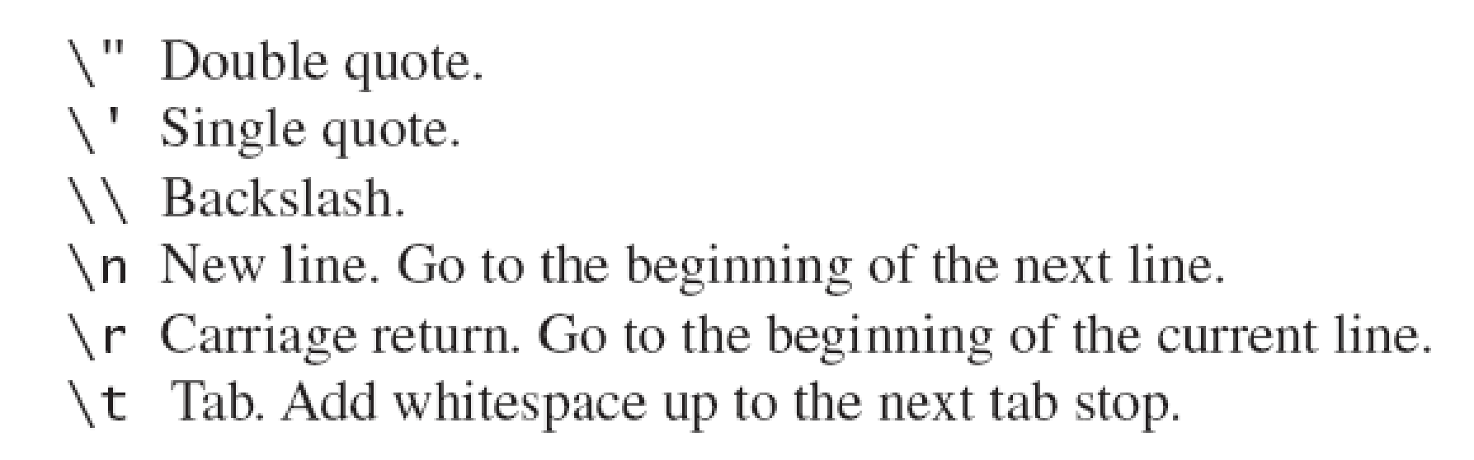
Escape Characters
Each escape sequence is a single character even though it is written with two symbols.

Slide 46
Examples
System.out.println("abc\\def");
System.out.println("new\nline");
char singleQuote = '\'';
System.out.println(singleQuote);
abc\def
new
line
'

Slide 47
The Unicode Character Set
Most programming languages use the ASCII character set.
Java uses the Unicode character set which includes the ASCII character set.
The Unicode character set includes characters from many different alphabets (but you probably won't use them).
Ex) Hangul, Chinese characters, Arabic characters, …

Slide 48
Agenda
Variables and Expressions
The Class String
Keyboard and Screen I/O
Documentation and Style

Slide 49
Screen Output
System.out is an object that is part of Java.
println() is one of the methods available to the System.out object.
The concatenation operator (+) is useful when everything does not fit on one line.
Ex) System.out.println("Lucky number = " + 13 +
"Secret number = " + number);
Do not break the line except immediately before or after the concatenation operator (+).

Slide 50
Screen Output
Alternatively, use print()
System.out.print("One, two,");
System.out.print(" buckle my shoe.");
System.out.println(" Three, four,");
System.out.println(" shut the door.");
ending with a println().
Result
One, two, buckle my shoe. Three, four,
shut the door.

Slide 51
Keyboard Input
Java has reasonable facilities for handling keyboard input.
These facilities are provided by the Scanner class in the java.util package.
A package is a library of classes.

Slide 52
Using the Scanner Class
Near the beginning of your program, insert
import java.util.Scanner;
Create an object of the Scanner class
Scanner keyboard = new Scanner (System.in)
Read data (an int or a double, for example)
int n1 = keyboard.nextInt();
double d1 = keyboard.nextDouble();

Slide 53
ScannerDemo (Listing 2.5)
import java.util.Scanner;
public class ScannerDemo
{
public static void main (String [] args)
{
Scanner keyboard = new Scanner (System.in);
System.out.println ("Enter two whole numbers");
System.out.println ("separated by one or more spaces:");
int n1, n2;
n1 = keyboard.nextInt ();
n2 = keyboard.nextInt ();
System.out.println ("You entered " + n1 + " and " + n2);
System.out.println ("Next enter two numbers.");
System.out.println ("A decimal point is OK.");
double d1, d2;
d1 = keyboard.nextDouble ();
d2 = keyboard.nextDouble ();
System.out.println ("You entered " + d1 + " and " + d2);
System.out.println ("Next enter two words:");
String s1, s2;
s1 = keyboard.next ();
s2 = keyboard.next ();
System.out.println ("You entered \"" + s1 + "\" and \"" + s2 + "\"");
s1 = keyboard.nextLine (); //To get rid of '\n'
System.out.println ("Next enter a line of text:");
s1 = keyboard.nextLine ();
System.out.println ("You entered: \"" + s1 + "\"");
}
}

Slide 54
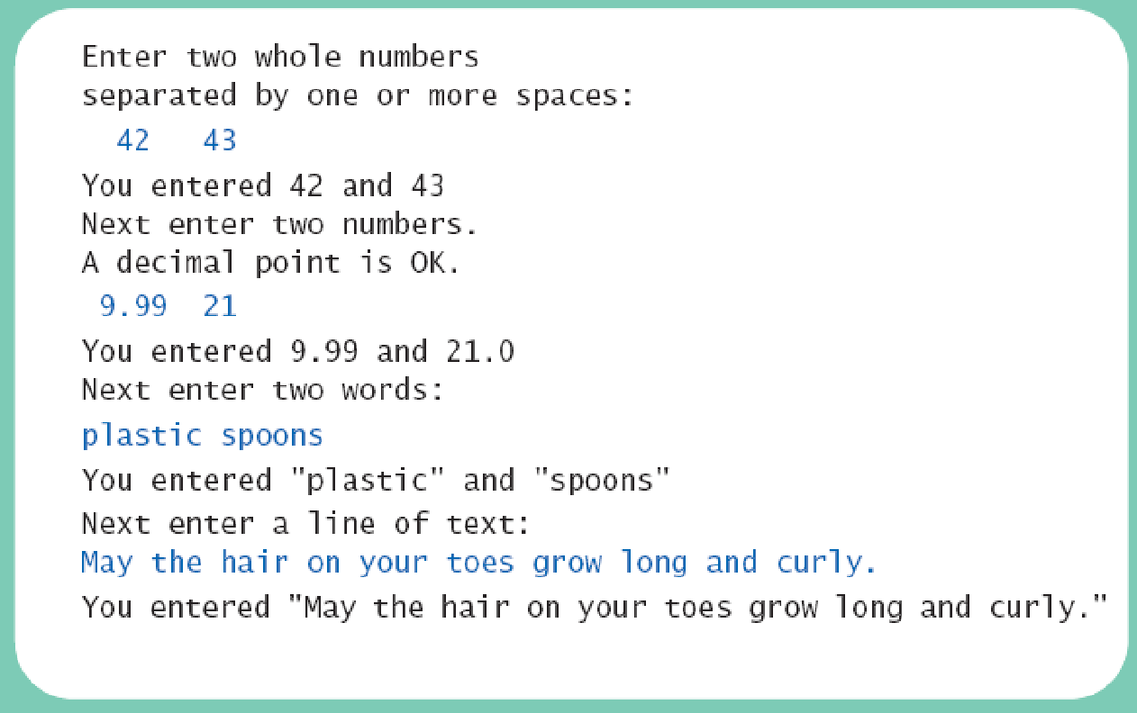
ScannerDemo (Listing 2.5)

Slide 55
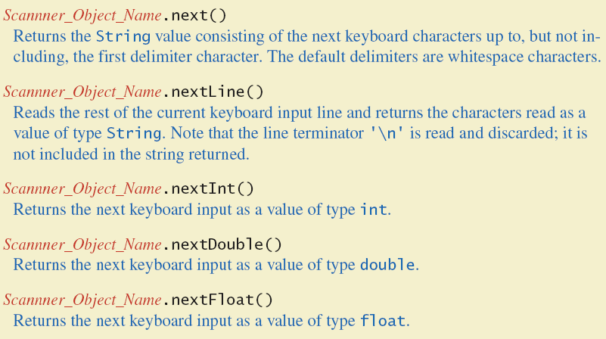
Some Scanner Class Methods

Slide 56
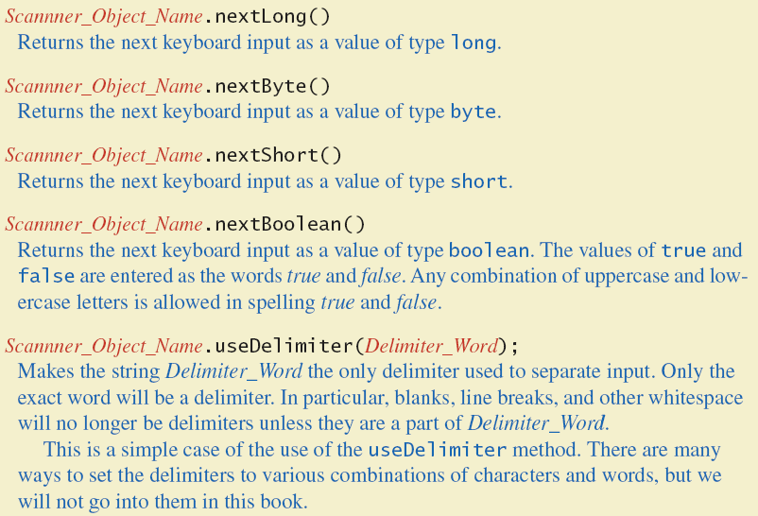
Some Scanner Class Methods

Slide 57
nextLine()Method Caution
The nextLine() method reads
The remainder of the current line,
Even if it is empty.
Ex)
int n; String s1, s2; n = keyboard.nextInt(); s1 = keyboard.nextLine(); s2 = keyboard.nextLine();
Assume input shown
n is set to 42
but s1 is set to the empty string.
42
and don't you
forget it.

Slide 58
The Empty String
A string can have any number of characters, including zero.
The string with zero characters is called the empty string.
The empty string is useful and can be created in many ways including
String s3 = "";

Slide 59
Other Input Delimiters (optional)
Almost any combination of characters and strings can be used to separate keyboard input.
Ex) Change the delimiter to "##"
keyboard2.useDelimiter("##");
whitespace will no longer be a delimiter for keyboard2 input

Slide 60
Agenda
Variables and Expressions
The Class String
Keyboard and Screen I/O
Documentation and Style

Slide 61
Documentation and Style
Most programs are modified over time to respond to new requirements.
Programs which are easy to read and understand are easy to modify.
Even if it will be used only once, you have to read it in order to debug it.

Slide 62
Meaningful Variable Names
A variable's name should suggest its use.
Observe conventions in choosing names for variables.
Use only letters and digits.
"Punctuate" using uppercase letters at word boundaries (e.g. taxRate).
Start variable names with lowercase letters.
Start class names with uppercase letters.

Slide 63
Comments
Comments are written into a program as needed explain the program.
They are useful to the programmer, but they are ignored by the compiler.
A comment can begin with //.
Everything after these symbols and to the end of the line is treated as a comment and is ignored by the compiler.
double radius; // in centimeters

Slide 64
Comments
A comment can begin with /* and end with */
Everything between these symbols is treated as a comment and is ignored by the compiler.
/*
This program should only
be used on alternate Thursdays,
except during leap years, when it should
only be used on alternate Tuesdays.
*/

Slide 65
Comments
A javadoc comment, begins with /** and ends with */.
It can be extracted automatically from Java software.
/**
method change requires the number of coins to be nonnegative
*/

Slide 66
When to Use Comments
Begin each program file with an explanatory comment
What the program does
The name of the author
Contact information for the author
Date of the last modification.
Provide only those comments which the expected reader of the program file will need in order to understand it.

Slide 67
Indentation
Indentation should communicate nesting clearly.
Proper indentation helps communicate to the human reader the nested structures of the program
A good choice is four spaces (or a tab) for each level of indentation.
Indentation should be consistent.
Indentation should be used for second and subsequent lines of statements which do not fit on a single line.

Slide 68
Using Named Constants
To avoid confusion, always name constants (and variables).
area = PI * radius * radius;
is clearer than
area = 3.14159 * radius * radius;
Place constants near the beginning of the program.
Once the value of a constant is set (or changed by an editor), it can be used (or reflected) throughout the program.
Ex) public static final double INTEREST_RATE = 6.65;
If a literal (such as 6.65) is used instead, every occurrence must be changed, with the risk than another literal with the same value might be changed unintentionally.

Slide 69
Declaring Constants
Syntax
public static final Variable_Type = Constant;
Ex) Examples
public static final double PI = 3.14159;
public static final String MOTTO = "The customer is always right.";
By convention, uppercase letters are used for constants.

Slide 70
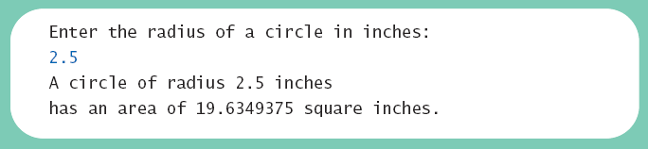
Named Constants
import java.util.Scanner;
public class CircleCalculation2
{
public static final double PI = 3.14159;
public static void main (String [] args)
{
double radius; //in inches
double area; //in square inches
Scanner keyboard = new Scanner (System.in);
System.out.println ("Enter the radius of a circle in inches:");
radius = keyboard.nextDouble ();
area = PI * radius * radius;
System.out.println ("A circle of radius " + radius + " inches");
System.out.println ("has an area of " + area + " square inches.");
}
}

